Slide 1
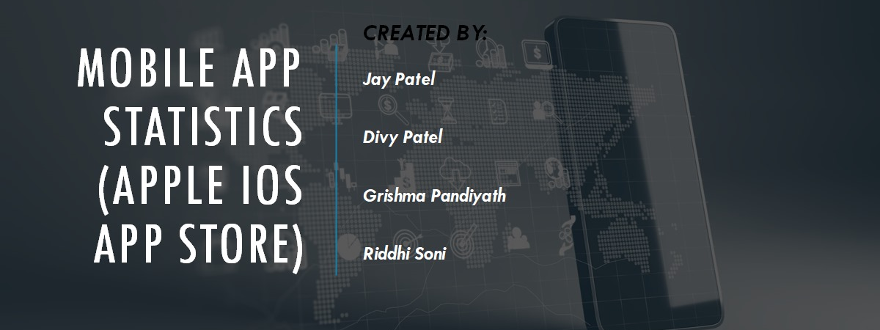
PROF. KSHITIJ SHARMA
CRN: 73545

Slide 2

Abstract
Goal:
The primary goal of this project is to explore and analyze iOS app data to uncover significant insights that can inform app development, distribution, and marketing strategies. The aim is to provide a comprehensive understanding of the factors that contribute to app success in the Apple iOS App Store.
Objective:
The objective is to conduct a thorough analysis of 7,197 apps from the iOS App Store, focusing on key metrics such as app ratings, price, genre, size, supported devices, and content categories. This involves data cleaning, preprocessing, and visualization to identify patterns in app popularity, pricing trends, user engagement, and content distribution across different genres. By doing so, the project aims to equip developers and marketers with actionable insights that can help optimize app performance and enhance user satisfaction.

Slide 3

Introduction
Background: The mobile app industry has exploded over the past decade, transforming into an intensely competitive space where thousands of new apps enter the scene every day. For developers and businesses, standing out means more than just creating a great app; it involves making smart, data-driven decisions on everything from pricing to content strategy. The Apple iOS App Store is a vast marketplace filled with apps across various categories—from addictive games to must-have productivity tools—and understanding what works can be a game-changer.
This project is built around a dataset of 7,197 iOS apps, capturing details like user ratings, price, app size, genre, and supported devices. By cleaning, analyzing, and visualizing this data, we can reveal the trends and characteristics that contribute to an app’s popularity and success. Whether it's uncovering what type of content attracts the most users or which pricing models work best, these insights are essential for developers and marketers looking to optimize their app strategies.
Data Attributes:
Identifiers: App ID, Name
User Engagement: User ratings, rating counts (total and current version)
Financial Aspects: Price, currency
Technical Specs: App size, supported devices, and language options
Categorical Insights: Genre, content rating
Business Problem: In today’s fast-paced mobile app market, developers and marketers are constantly trying to figure out how to make their apps stand out among millions in the Apple iOS App Store. The challenge lies in understanding what makes an app successful—what pricing strategies, features, or content resonate most with users. This project aims to tackle that problem by diving deep into iOS app data to find patterns that can guide these crucial decisions. The end goal is to empower app creators with insights that lead to better app performance, increased user engagement, and sustainable revenue growth.

Slide 4

Adding Dataset for EDA
# Import necessary libraries
import pandas as pd
import numpy as np
import matplotlib.pyplot as plt
import seaborn as sns
import squarify # pip install squarify (algorithm for treemap)
import os
import math
apps = pd.read_csv(r"C:\Users\princ\Desktop\PACE Docs\Fall\Python\Midterm Project\AppleStore.csv", index_col=[0])
apps.head()

Slide 5

Dataset
"user_rating" : Average User Rating value (for all version)
"user_rating_ver": Average User Rating value (for current version)
"ver" : Latest version code
"cont_rating": Content Rating
"prime_genre": Primary Genre
"sup_devices.num": Number of supporting devices
"ipadSc_urls.num": Number of screenshots showed for display
"lang.num": Number of supported languages
"vpp_lic": Vpp Device Based Licensing Enabled
Dataset: Mobile App Statistics (Apple iOS app store)
Link to the dataset : dataset
Fields are as follows:
"id" : App ID
"track_name": App Name
"size_bytes": Size (in Bytes)
"currency": Currency Type
"price": Price amount
"rating_count_tot": User Rating counts (for all version)
"rating_count_ver": User Rating counts (for current version)

Slide 6
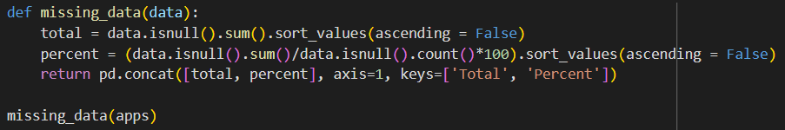
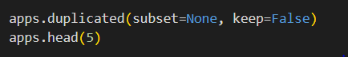
Preprocessing
Handling Missing Data
Defined a function to identify missing data.
Calculated the total and percentage of missing values for each column.
Sorted columns by the amount of missing data to prioritize cleaning efforts.
Detecting Duplicates
Checked for duplicate rows in the dataset to ensure data integrity.
Displayed the first five rows to verify and inspect data consistency.

Slide 7
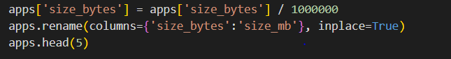
Preprocessing
Converting app sizes from bytes to megabytes (MB) is a simple but essential step that makes data analysis much clearer. App sizes in bytes are often huge numbers that are tough to read and compare. By changing them to MB, the data becomes more straightforward and easier to work with. This change matches industry standards and helps create cleaner, more informative charts and tables. using MB makes the analysis clearer, more consistent, and easier to understand.

Slide 8
Literature Review
Genre Popularity: Key to app success in digital stores. Research shows:
Gaming genre accounts for 21% of downloads; primarily free apps dominate (Xu et al., 2015).
Niche genres (e.g., education) tend to perform better with paid models.
Free vs. Paid Apps:
Free apps see higher downloads but often lower ratings due to user diversity.
Paid apps achieve better ratings, particularly in specialized genres, indicating user willingness to pay for quality (Kim & Lee, 2018).

Slide 9
Literature Review
Importance of Device Compatibility: Apps supporting multiple devices yield higher user engagement.
Multi-language apps see 30% more downloads compared to single-language counterparts (Meyer et al., 2019).
High-Rated Apps: Often optimized for various platforms; compatibility enhances user satisfaction.
Apps supporting over five devices retain users better over six months, especially in gaming and productivity (Lee & Cho, 2020).
Conclusion: Genre choice, pricing strategy, device support, and localization are crucial for app success, guiding developers to enhance performance across diverse demographics.

Slide 10

Architecture / Methodology
Introduction Brief overview of the dataset: Mobile App Statistics from the iOS App Store, including app ID, name, size, price, rating counts, user rating, primary genre, supported devices, languages, and licensing information.
Data Loading
Load dataset using Pandas.
Overview of dataset structure and data types.
Data Preprocessing
Missing Values Check: Identify and handle missing or empty values.
Duplicates Removal: Remove any duplicate rows to ensure data quality.
Data Transformation: Convert app size from bytes to megabytes for readability.

Slide 11

Architecture / Methodology
Exploratory Data Analysis (EDA)
Analysis of genres, free and paid apps distribution.
Identify popular apps by ratings.
Explore the genre distribution of high-rated apps (4-5 ratings).
Breakdown of apps supporting multiple languages and devices.
Correlation Analysis
Pearson Correlation: Explore correlations between variables, e.g., size, ratings, and supported devices.
Feature Engineering
Creation of new features or transformations to enrich dataset for analysis.

Slide 12
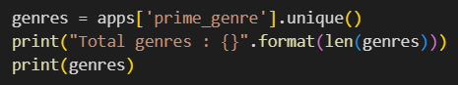
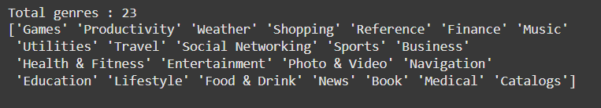
Insights:
Finding different kind of genres:
Finding the unique app genres is important because it helps us get a clear view of the types of apps available in the dataset. This information is useful for spotting trends in the market and understanding what users are interested in. It also makes it easier to compare data across different genres, like looking at which categories have the highest user engagement or best ratings. knowing the app genres helps developers and marketers make smarter decisions, whether it’s about creating new apps, improving existing ones, or finding ways to stand out from competitors.

Slide 13
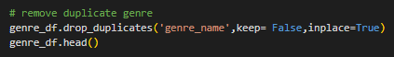
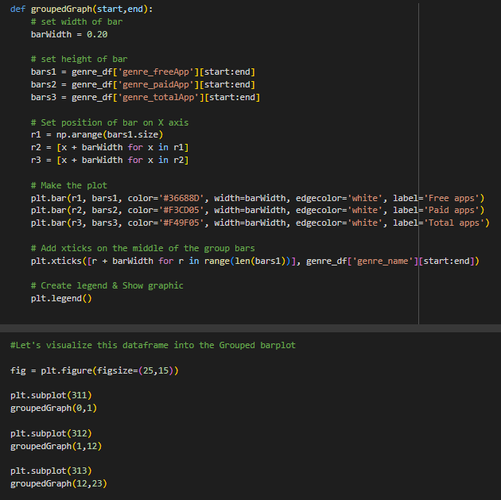
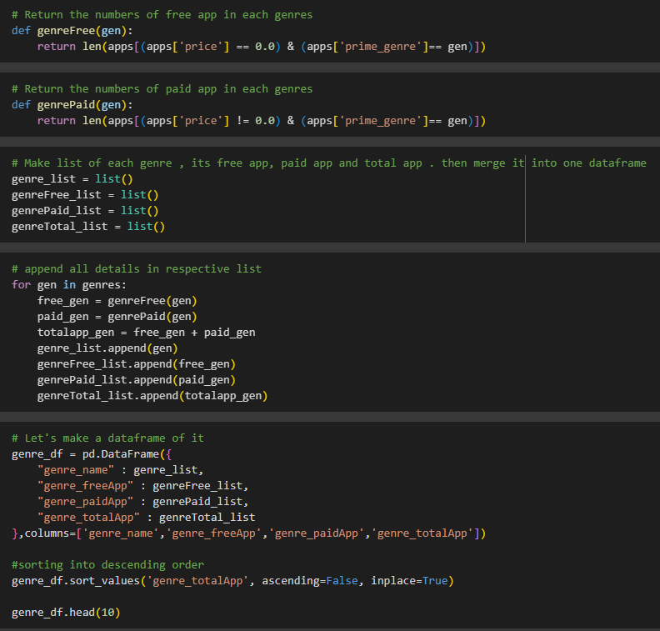
Insights:
Find Free and paid apps in all genres:
Code:

Slide 14
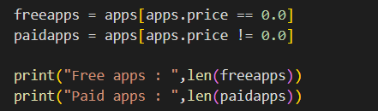
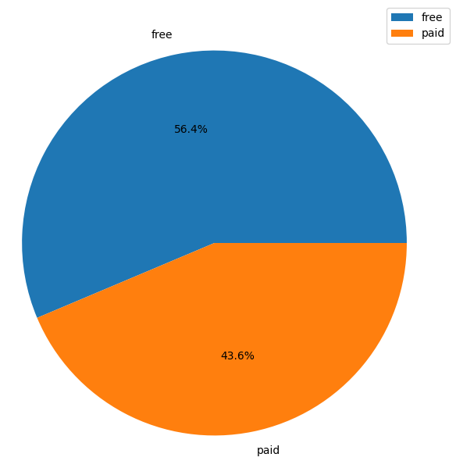
Insights:
Find Total free and paid apps:
Our analysis showed that out of 7,197 apps, 56.4% (4,056) are free, while 43.6% (3,141) are paid. This indicates that free apps have a slight edge in numbers, which aligns with the trend of attracting more users by offering apps for free and monetizing through ads or in-app purchases. Understanding this balance between free and paid apps can help developers and marketers make smarter choices about pricing strategies and how to position their apps in a competitive market.

Slide 15
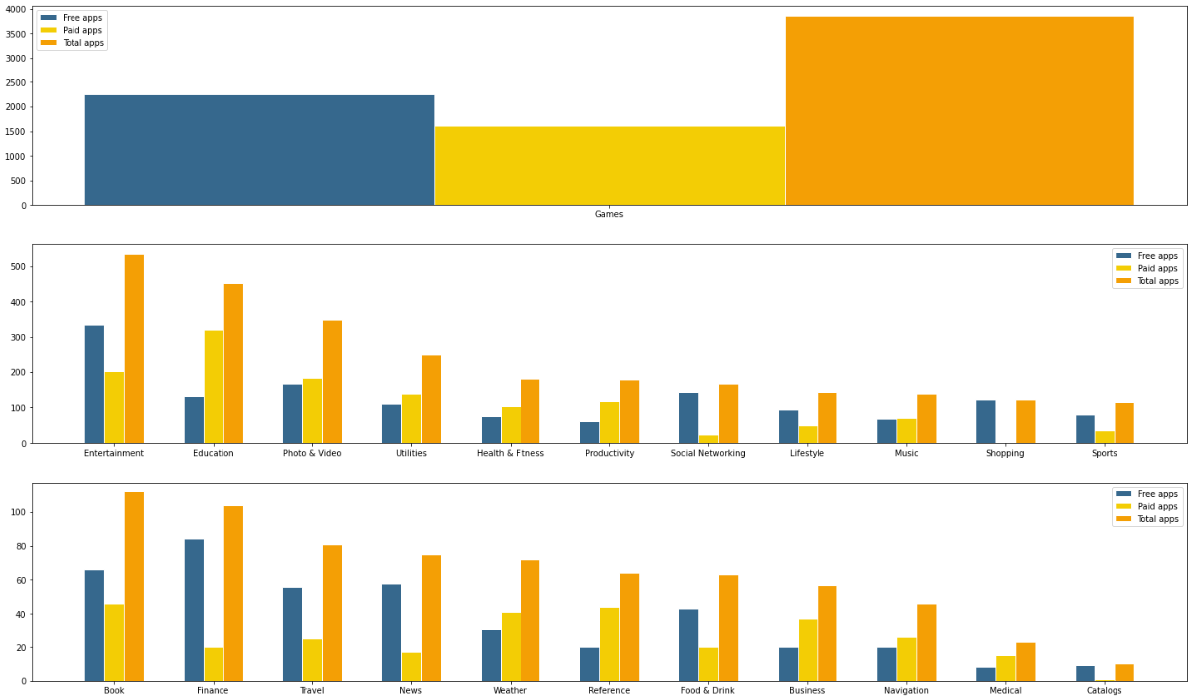
Insights:
Find Free and paid apps in all genres:
The visual analysis of free and paid apps across different genres provided some interesting insights. Games stand out as the most popular genre with a significant number of total apps, followed by Entertainment and Education. The charts show a clear comparison between free and paid apps within each category, revealing that most genres have a higher number of free apps compared to paid ones. This emphasizes the trend of offering free apps to attract users and drive engagement. However, some categories like Productivity and Finance show a more balanced split between free and paid apps, suggesting different monetization strategies based on the genre. Overall, these insights help highlight which app categories dominate the market and how their pricing models vary.

Slide 16
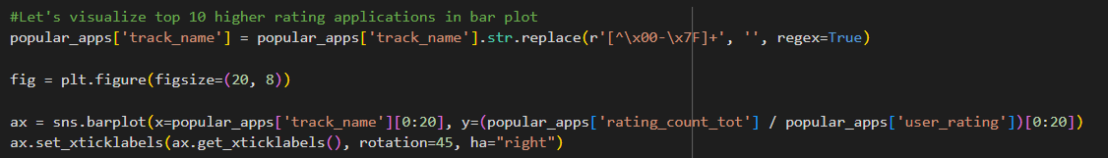

Insights:
Find Most Popular apps in all Genres:
To gain insights into the most popular apps, we sorted the dataset by user ratings and total rating counts. This allowed us to identify the top-rated apps based on user feedback and engagement. We then visualized the top 10 highest-rated apps in a bar chart, showcasing which apps received the most positive responses and high user interaction. This analysis helps highlight which apps are resonating well with users and provides a benchmark for developers aiming to enhance user satisfaction and engagement.

Slide 17
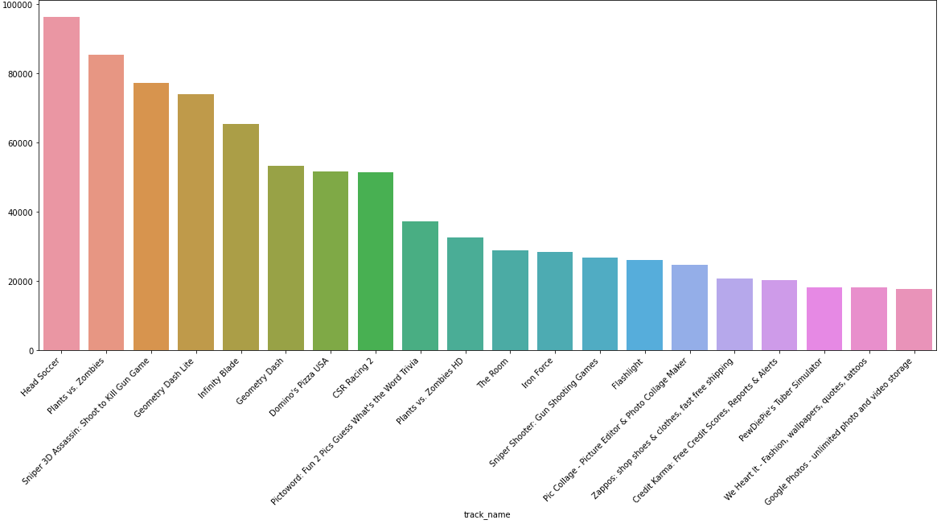
Insights:
Find Most Popular apps in all Genres:
The analysis of the highest-rated apps revealed the top 10 apps with the most user engagement and positive feedback. The bar chart highlights apps like "Heads Up!" and "Plants vs. Zombies" as leaders in user ratings and review counts. These apps have successfully captured user interest, making them standout examples of high user satisfaction and engagement. This insight is valuable for developers and marketers aiming to understand what makes an app popular and well-received, providing a benchmark for quality and user appeal in app development strategies.

Slide 18
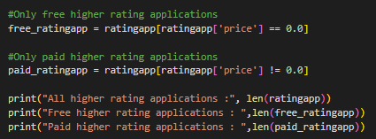
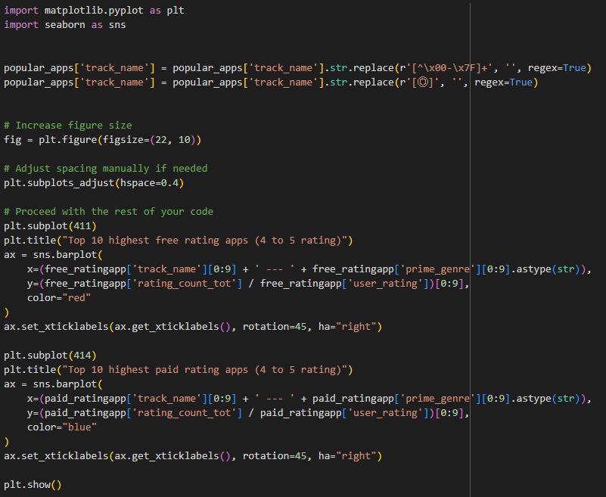
Insights:
Find Total Free and Paid apps in the list of popular apps (rating 4 to 5):
We analyzed apps with higher user ratings (4.0, 4.5, and 5.0) to identify which ones stood out in terms of positive feedback. This analysis helped us differentiate between highly rated free and paid apps, showcasing their distribution. We found that a notable number of both free and paid apps achieved high ratings, reflecting strong user satisfaction. Visualizing the top 10 apps from each group provided a clearer understanding of which types of apps excel in user ratings and engagement. These insights can guide developers and businesses in understanding what factors contribute to higher user satisfaction and in shaping strategies for both free and paid app offerings.

Slide 19
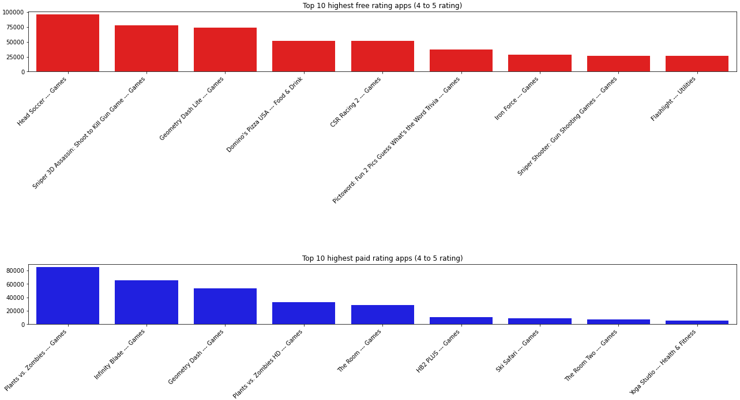
Insights:
Find Total Free and Paid apps in the list of popular apps (rating 4 to 5):
Our analysis revealed the top 10 highest-rated free and paid apps with ratings between 4 and 5. For free apps, popular names like "Heads Up!" and "CSR Racing 2" stood out, showing strong user engagement and satisfaction in gaming and entertainment categories. In the paid apps category, titles such as "Plants vs. Zombies" and "Infinity Blade" led the way, showcasing that users are willing to invest in quality games with high ratings. This comparison highlights the types of apps that succeed in both free and paid models and provides valuable insights for developers and businesses on where to focus their efforts to achieve high user ratings and engagement.

Slide 20
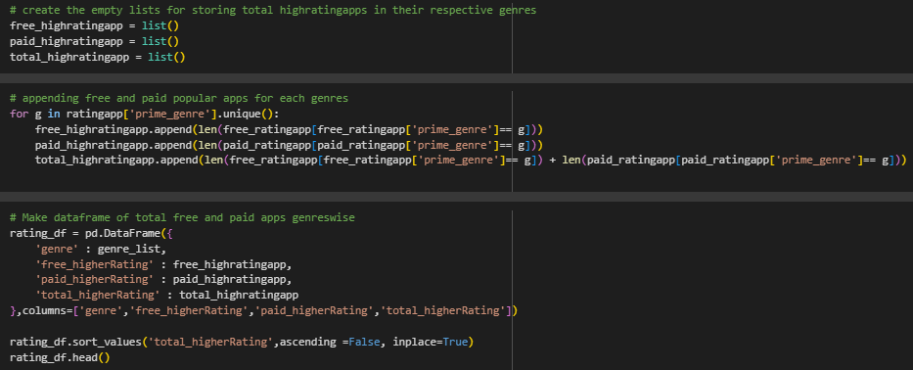
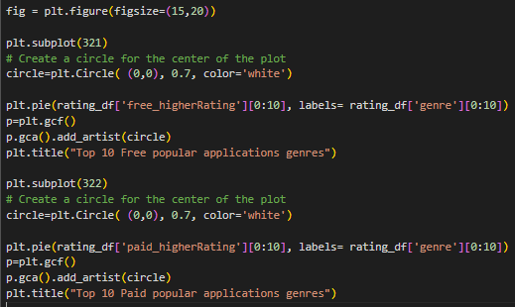
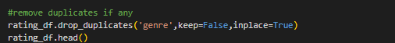
Insights:
Find Most Popular Genres in Free apps and Paid apps:
We categorized the highest-rated apps by genre to see how they were distributed between free and paid options. By creating lists of these apps and building a dataset, we were able to show which genres had the most highly-rated apps. We visualized this using pie charts, showing the top 10 genres for both free and paid apps. This analysis gives a clear view of the genres that users appreciate the most, helping developers focus on categories that are performing well and tailor their strategies to match user interests.

Slide 21
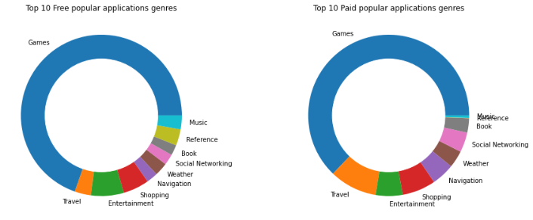
Insights:
Find Most Popular Genres in Free apps and Paid apps:
The analysis of the top 10 popular genres for both free and paid apps revealed some key patterns. For both categories, games were the most dominant genre, highlighting their universal appeal and user engagement. Other notable genres for free apps included entertainment, travel, and shopping, while paid apps showed a strong presence in genres like navigation, entertainment, and shopping as well. This breakdown provides valuable insight into which types of apps resonate most with users and shows developers where there may be opportunities to succeed, whether through a free or paid app model.

Slide 22
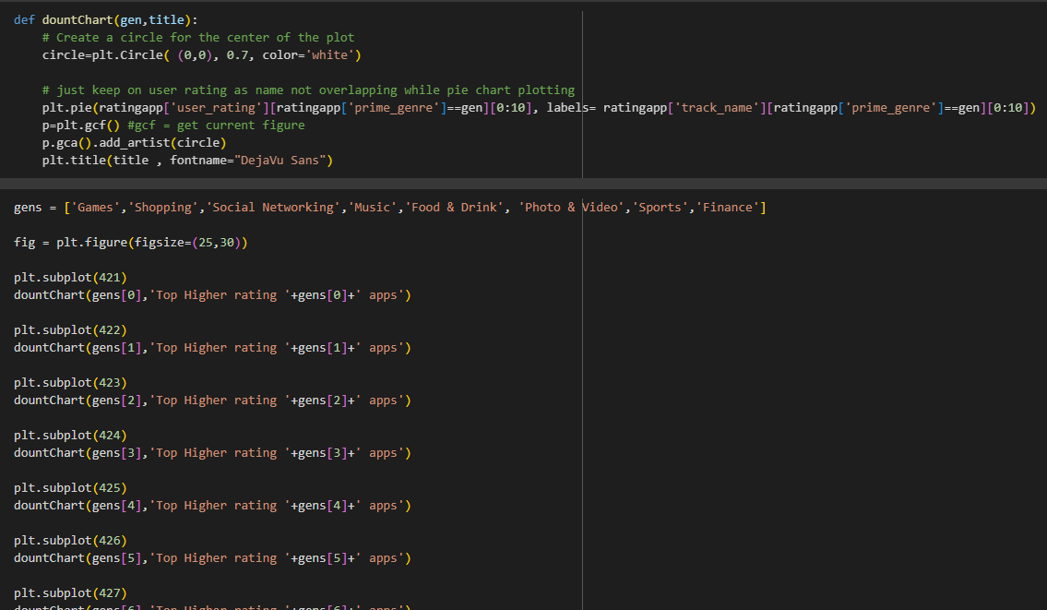
Insights:
Find Most High rating apps in all Genres:
We created detailed visualizations to show the top-rated apps within various popular genres, such as Games, Shopping, and Social Networking. By generating donut charts for each genre, we could highlight the top 10 highly-rated apps and their share within their respective categories. This analysis offers a clearer view of which apps stand out in terms of user ratings within each popular genre, helping developers and businesses identify which types of apps resonate most with users and which areas may offer growth opportunities.

Slide 23
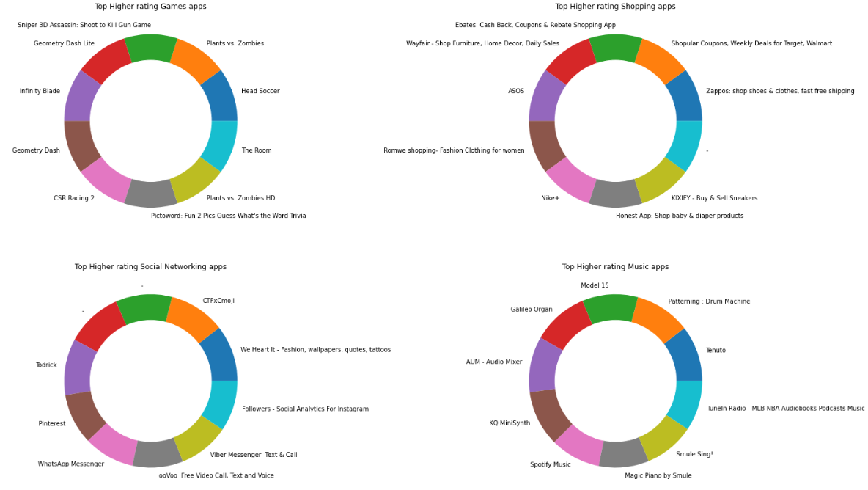
Insights:
Find Most High rating apps in all Genres:
Our analysis identified the top highly-rated apps within popular genres, represented by donut charts for categories like Games, Shopping, Social Networking, and Music. Notable high-rating apps include “Plants vs. Zombies” in Games, “Pinterest” in Social Networking, and “Spotify Music” in Music. These charts illustrate which apps within each genre resonate most with users, showcasing standout titles that have successfully captured user engagement and high ratings. This insight helps developers and marketers focus on what drives user satisfaction in different categories, offering valuable benchmarks for app development and marketing strategies.

Slide 24
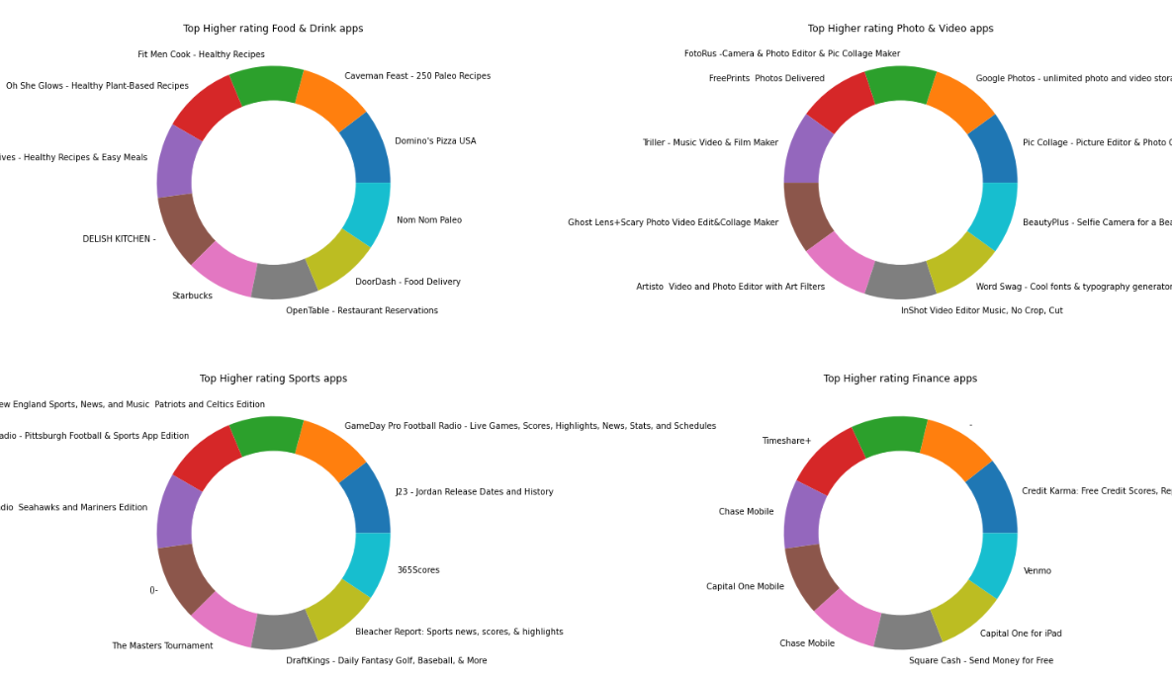
Insights:
Find Most High rating apps in all Genres:
Our analysis showcased the top highly-rated apps across various genres, such as Food & Drink, Photo & Video, Sports, and Finance. The donut charts for each genre highlighted standout apps like "Fit Men Cook" in Food & Drink, "Google Photos" in Photo & Video, and "Venmo" in Finance. These visualizations revealed which apps have achieved high user ratings within their categories, indicating strong user approval and engagement. This insight is useful for understanding which types of apps resonate most with users, helping developers and marketers prioritize features and strategies that align with user preferences in different app categories.

Slide 25
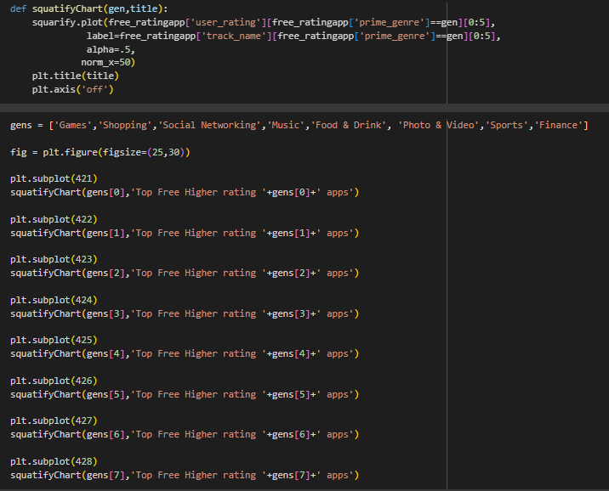
CODE:

Slide 26
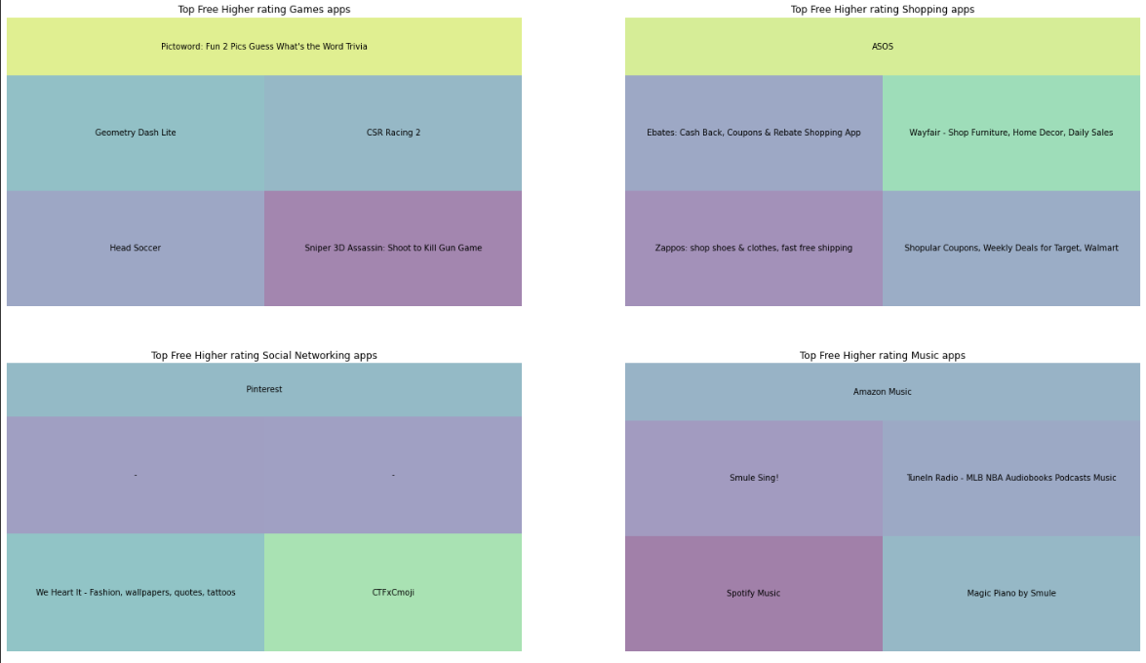
Insights:
Find Most High rating Free apps in all Genres:
Our analysis identified the highest-rated free apps across different genres. In the Games category, apps like “Pictoword” and “Geometry Dash Lite” stood out, showcasing strong user approval. In Shopping, “ASOS” and “Ebates” led the way, indicating their popularity and positive reception. For Social Networking, “Pinterest” and “We Heart It” were highlighted, while in Music, apps such as “Amazon Music” and “Spotify Music” were top-rated by users. These insights help pinpoint which free apps are resonating most with users in each genre, providing valuable benchmarks for developers looking to understand successful features and strategies in their respective categories.

Slide 27
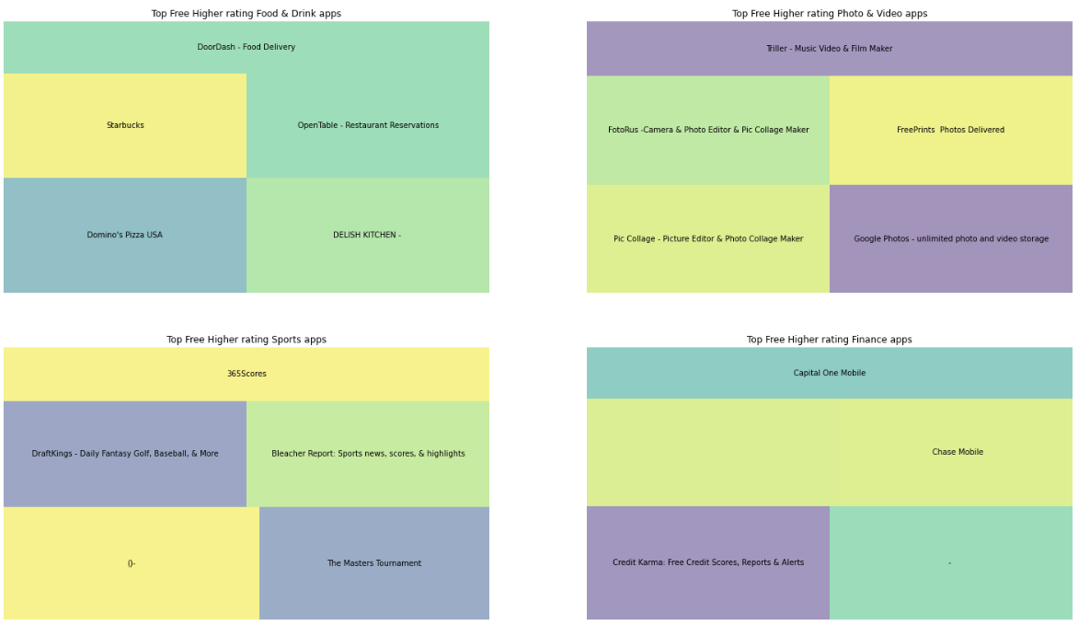
Insights:
Find Most High rating Free apps in all Genres:
Our analysis of highly-rated free apps across different genres revealed standout performers. In the Food & Drink category, apps like “DoorDash” and “Starbucks” led the way with strong user ratings. For Photo & Video, “Tiller - Music Video & Film Maker” and “Google Photos” were top-rated, indicating their popularity. In Sports, “365Scores” and “Bleacher Report” were user favorites, while in Finance, “Capital One Mobile” and “Chase Mobile” ranked highly. These insights help identify which free apps in various genres resonate best with users, offering valuable guidance for developers and marketers aiming to understand user preferences and enhance their offerings.

Slide 28
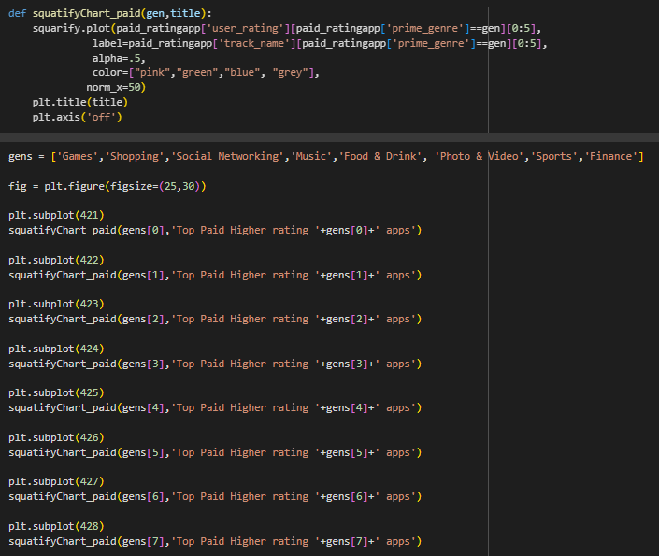
CODE:

Slide 29
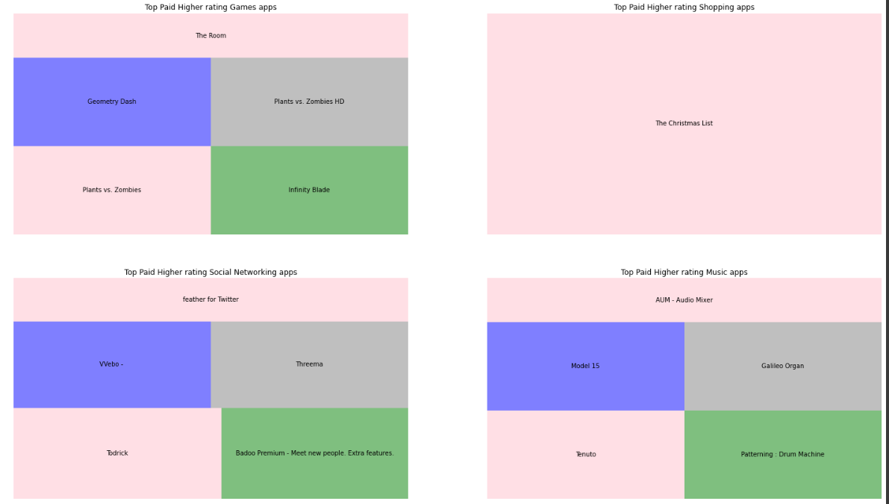
Insights:
Find Most High rating Free apps in all Genres:
Our analysis of the top-rated paid apps across various genres highlighted key performers. In Games, titles like “The Room,” “Plants vs. Zombies HD,” and “Infinity Blade” were highly rated by users, reflecting their strong engagement and popularity. The Shopping genre was led by “The Christmas List,” showcasing a niche yet highly appreciated app. In Social Networking, apps like “feather for Twitter” and “Vello” stood out, while in Music, “AUM - Audio Mixer” and “Model 15” were among the top-rated. These insights provide a clearer understanding of which paid apps resonate well with users in different categories, helping developers and marketers focus on successful elements that drive high user satisfaction and engagement.

Slide 30
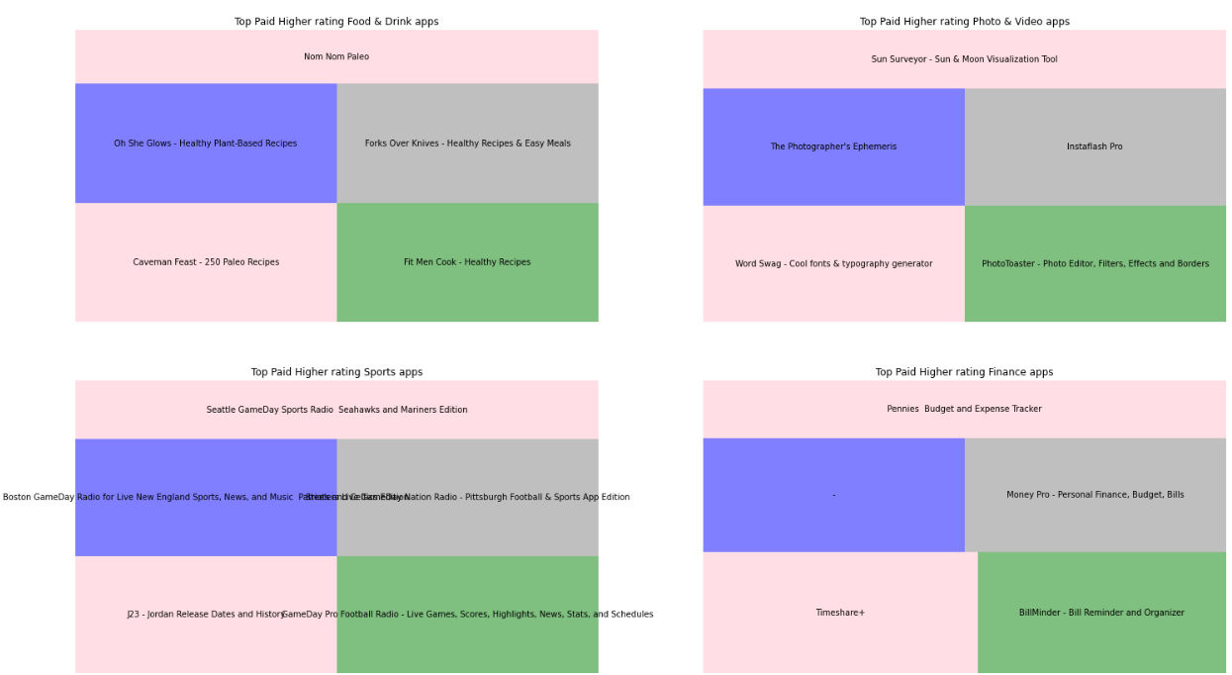
Insights:
Our analysis of top-rated paid apps in different genres highlighted key performers that resonated with users. In the Food & Drink category, apps like “Oh She Glows” and “Fit Men Cook” stood out for their high ratings, showcasing their popularity among users seeking healthy recipes. In the Photo & Video genre, “The Photographer’s Ephemeris” and “PhotoToaster” were highly regarded for their advanced editing tools. For Sports, “Seattle GameDay Sports Radio” and “J23 - Jordan Release Dates” led the way, indicating a strong user base interested in specialized sports content. In Finance, apps like “Pennies - Budget and Expense Tracker” and “Money Pro” were favorites for budget management. These insights offer a clear view of which paid apps perform well in various categories, providing valuable direction for developers and businesses looking to focus on successful features and user preferences.

Slide 31
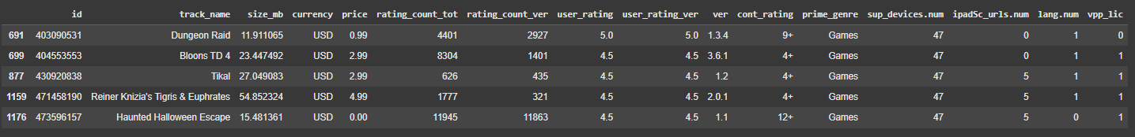
Insights:
Find Most Supported devices apps:
We analyzed the highest-rated apps based on the number of supported devices and user ratings. The results revealed that games like "Dungeon Raid" and "Bloons TD 4" not only had high ratings but were also optimized for a large number of devices, making them widely accessible. This insight highlights that successful apps often balance user satisfaction with broad device compatibility, an essential factor for reaching a wider audience and improving app performance. Developers can use this information to prioritize multi-device support when aiming for high user engagement and ratings.

Slide 32
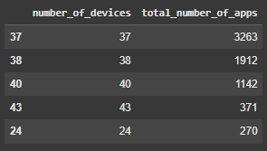
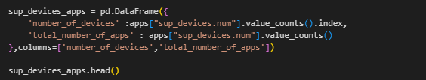
Insights:
Find Total apps in Most Supported devices:
Our analysis on the number of devices supported by various apps revealed that a significant number of apps are compatible with a range of devices. The data showed that most apps, specifically 3,263 of them, supported 37 devices, while others supported between 38 and 43 devices. This distribution indicates that many app developers are focusing on ensuring broad device compatibility to enhance user reach and satisfaction. Understanding this trend is essential for developers and businesses aiming to maximize their app's accessibility across multiple devices.

Slide 33
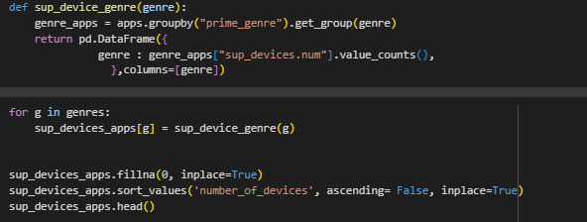
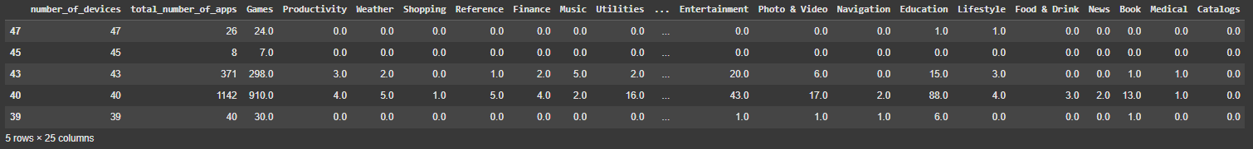
Insights:
Find Total apps in Most Supported devices genre wise:
The analysis of app genres based on the number of supported devices provided valuable insights into device compatibility across different categories. Apps supporting 47 devices were found across various genres, with significant representation in categories like Games and Entertainment. Other genres showed a varied distribution, highlighting how certain categories prioritize broader device support. This breakdown helps developers understand which app types tend to optimize for more extensive device compatibility, informing strategic decisions on app development and enhancements for user accessibility.

Slide 34
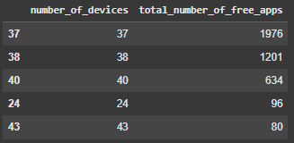
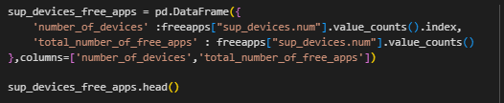
Insights:
Find Total Free apps in Most Supported devices:
Through this code snippet creates a DataFrame called sup_devices_free_apps to summarize the distribution of free apps based on the number of supported devices. It uses value_counts() on the sup_devices.num column from the freeapps DataFrame to count how many free apps support each number of devices, and these counts are used as the total_number_of_free_apps. The unique counts (number of devices) are set as number_of_devices. Finally, sup_devices_free_apps.head() displays the first few rows of this DataFrame, providing a quick view of how many free apps support different numbers of devices.

Slide 35
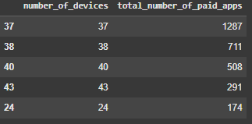
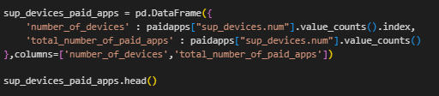
Insights:
Find Total Paid apps in Most Supported devices:
This code snippet creates a DataFrame called sup_devices_paid_apps to show the distribution of paid apps based on the number of supported devices. It uses value_counts() on the sup_devices.num column from the paidapps DataFrame to count how many paid apps support each number of devices. The unique counts are set as number_of_devices, and the corresponding counts as total_number_of_paid_apps. Finally, sup_devices_paid_apps.head() displays the first few rows of the DataFrame to provide an overview of how many paid apps support different numbers of devices.

Slide 36
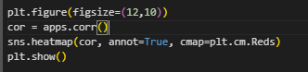
Insights:
Pearson Correlation:
This code creates a heatmap to visualize the correlation matrix of the apps DataFrame. It sets the plot size for readability, calculates correlations between numeric features (ranging from -1 to 1), and uses Seaborn to plot the heatmap with a red gradient. The annot=True option displays correlation values in each cell, and plt.show() renders the plot for analysis, highlighting relationships between features.

Slide 37
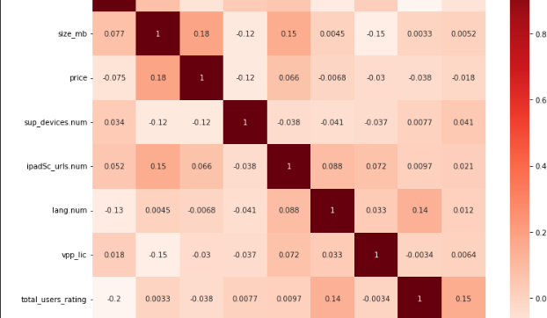
Insights:
Pearson Correlation:
The heatmap shows the correlation matrix of numeric features in the apps DataFrame. Darker red indicates stronger positive or negative correlations, while lighter shades suggest weak or no correlation. Diagonal values are 1.0, representing perfect self-correlation. This visualization helps identify relationships between variables, highlighting potential multicollinearity or independence, which can guide feature selection and further analysis.

Slide 38
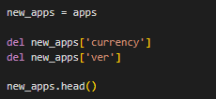
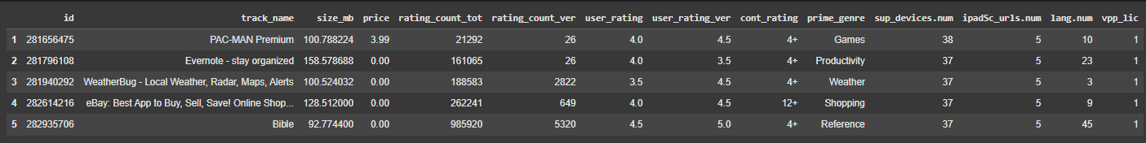
Insights:
Pearson Correlation:
In the context of the apps DataFrame, ver likely represents the version of the app. This column would contain information about the latest version code or number for each app in the dataset, indicating the version released on the iOS App Store.

Slide 39
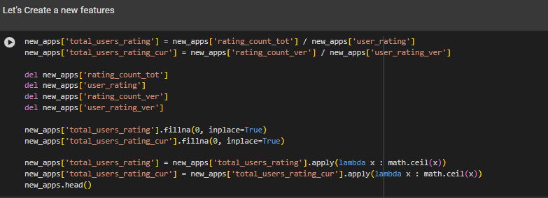
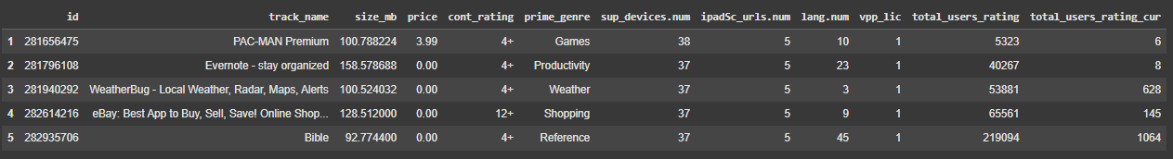
Insights:
Feature Engineering:
Create new features:
This code modifies the new_apps DataFrame by creating two new columns, total_users_rating and total_users_rating_cur, which estimate the total number of user ratings by dividing the total and current version rating counts by their respective user ratings. The original columns used for this calculation (rating_count_tot, user_rating, rating_count_ver, and user_rating_ver) are then deleted.
fillna(0, inplace=True) ensures that any NaN values in the new columns are replaced with 0. The apply(lambda x: math.ceil(x)) rounds up the values in these columns to the nearest whole number. Finally, new_apps.head() displays the first few rows of the modified DataFrame.

Slide 40
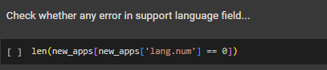
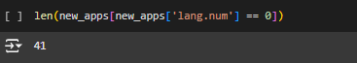
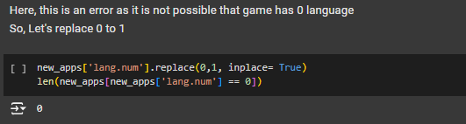
Insights:
Feature Engineering:
Check whether any error in support language field:
This code checks and modifies the lang.num column in the new_apps DataFrame:
len(new_apps[new_apps['lang.num'] == 0]): Counts the number of rows where the lang.num column (number of languages supported by an app) is 0.
new_apps['lang.num'].replace(0, 1, inplace=True): Replaces any 0 values in the lang.num column with 1, ensuring that apps showing zero language support are corrected to at least one language.
len(new_apps[new_apps['lang.num'] == 0]): Re-checks the count of rows where lang.num is 0 to confirm that no entries with 0 remain after the replacement.
This process ensures logical consistency in the data by avoiding apps that claim to support zero languages.

Slide 41
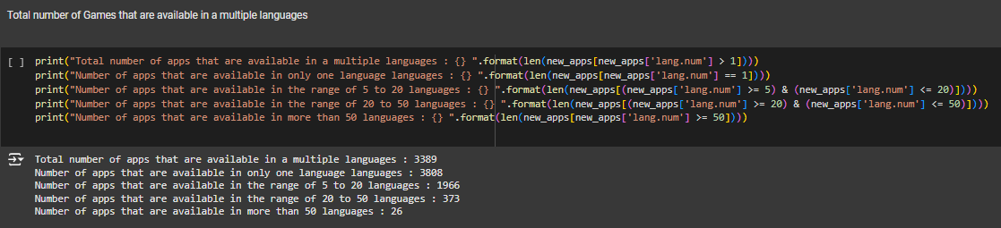
Insights:
Feature Engineering:
The analysis shows that out of all the apps, 3,389 are available in multiple languages, demonstrating a broad approach to accessibility. Notably, 3,080 apps are restricted to only one language, indicating a significant portion catering to specific linguistic audiences. Meanwhile, 1,966 apps support between 5 to 20 languages, showcasing moderate internationalization efforts. Additionally, 373 apps are available in 20 to 50 languages, indicating a more expansive global reach. A small yet noteworthy group of 26 apps offers support in more than 50 languages, exemplifying a strong commitment to global accessibility and catering to diverse user bases.

Slide 42
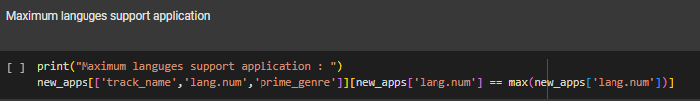

Insights:
Feature Engineering:
Maximum languages support application:
The analysis revealed that "Google Photos - unlimited photo and video storage" supports the highest number of languages, totaling 75. This highlights the app's extensive accessibility and its appeal to a global user base within the Photo & Video genre. This insight emphasizes the importance of language support for reaching diverse audiences, making it a crucial factor for app developers aiming for wide-scale international adoption.

Slide 43
Conclusion
In conclusion, our analysis of iOS app data reveals key insights for developers and marketers. Key findings include:
Genre & Pricing Strategy: Certain genres, especially gaming, attract higher downloads. Free apps generally see more downloads, while paid apps often receive better ratings, especially in niche categories.
Device Compatibility: Apps that support multiple devices and languages tend to retain users better and receive more engagement.
Impactful Factors for Success: Genre choice, pricing model, and localization are influential in an app's popularity and user satisfaction.
These insights serve as a foundation for app developers aiming to optimize user engagement and guide strategic development decisions.

Slide 44
References
1. Kim, J., & Lee, S. (2018). The impact of pricing model on mobile app success: A study of paid versus free apps. Journal of Business Research, 86, 44-52.
2. Lee, H., & Cho, J. (2020). Device compatibility and user retention in mobile applications: Evidence from high-rated apps. Computers in Human Behavior, 104, 106156.
3. Meyer, A., Bruns, D., & Schilling, A. (2019). Localization strategies in mobile applications: Effects on user engagement. International Journal of Information Management, 45, 112-120.
4. Xu, W., Park, S., & Kim, Y. (2015). An analysis of mobile app download trends: A genre-based approach. Computers in Human Behavior, 50, 32-39.

Slide 45

GitHub Repository for Code
Link : GITHUB LINK REPOSITORY

